Slide 1

December, 2020

Slide 2
CQG Spreader Demo
Palm Oil
Helmut Müller
Application Specialist
CQG since 1997

Slide 3
CQG Spreader – The Core
CQG China Data and Spreader Hub
Building the Malaysia - China Spread
Analyzing the Spread
Trading on Spreader

Slide 4
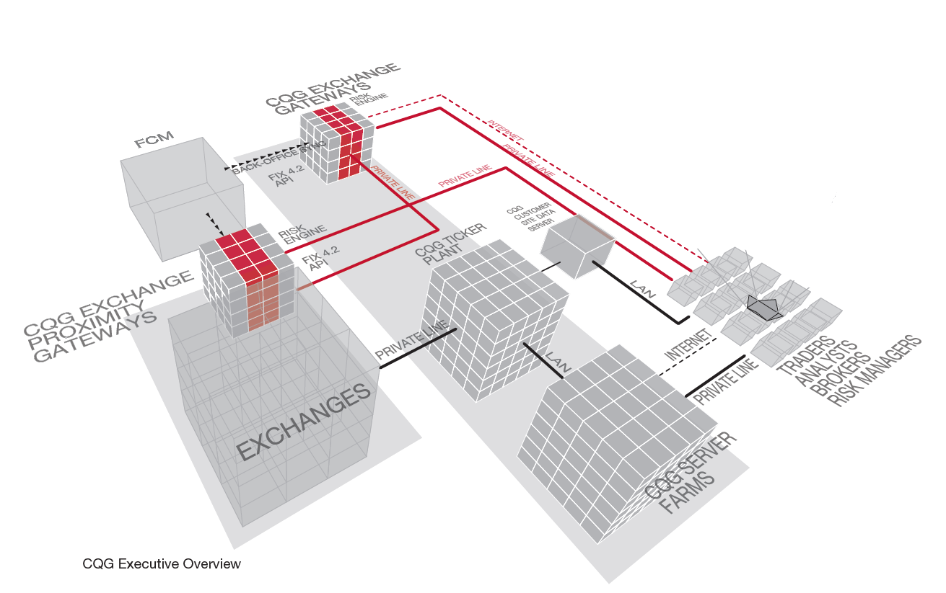
CQG Spreader – The Core

Slide 5
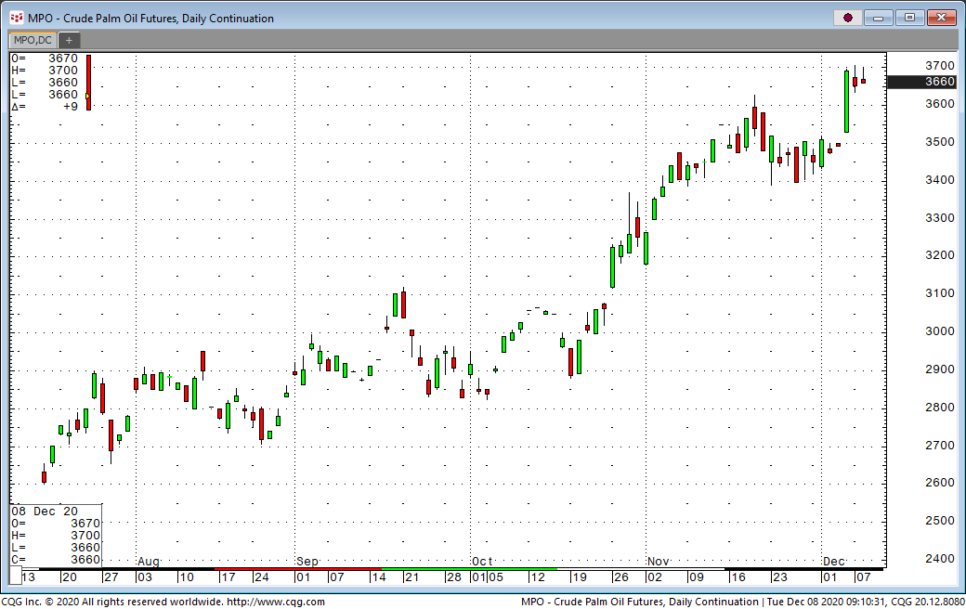
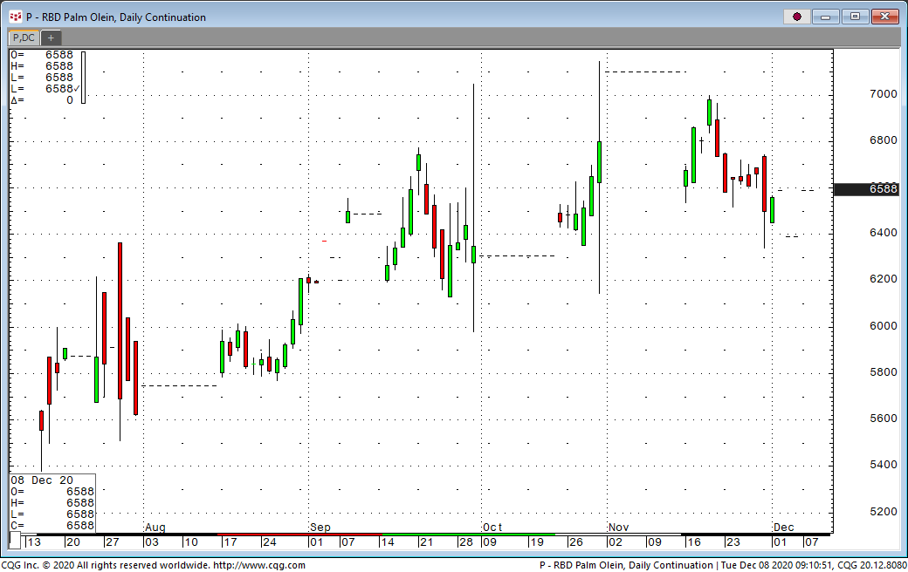
CQG Spreader – The Data

Slide 6
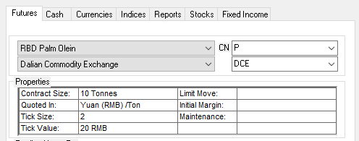
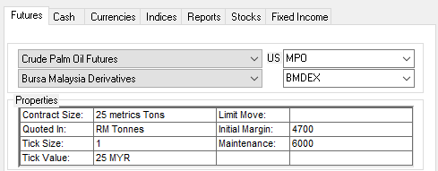
CQG Spreader – The Math
SPREAD(MPO/4.07*1.09*1.09-F.CN.P/6.53, , , 2:5)
MYR/USD VAT CUSTOMS RMB/USD
SPREAD(MPO*1.6*1.09*1.09-F.CN.P, , , 2:5)
MYR/USD VAT CUSTOMS

Slide 7
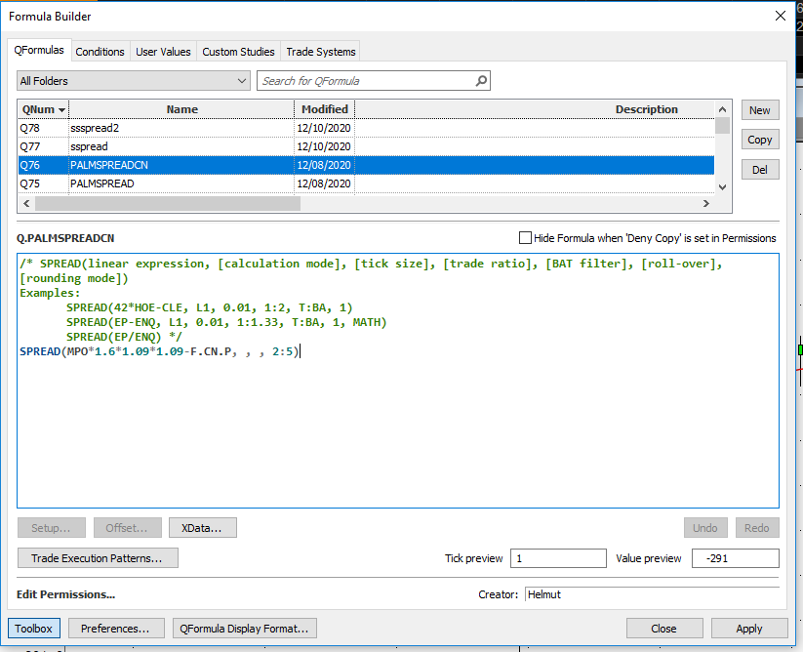
CQG Spreader – The Formula

Slide 8
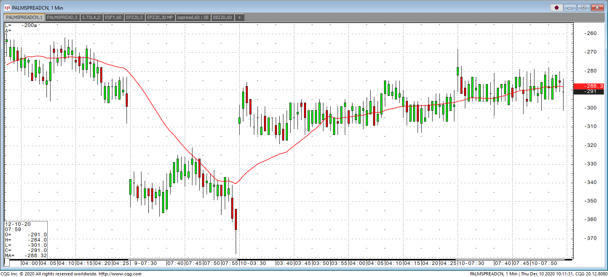
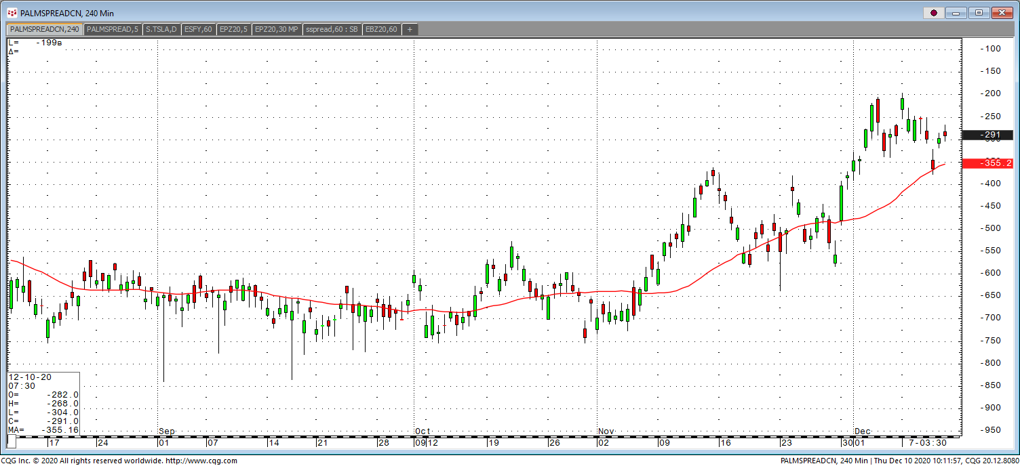
CQG Spreader – The Chart

Slide 9
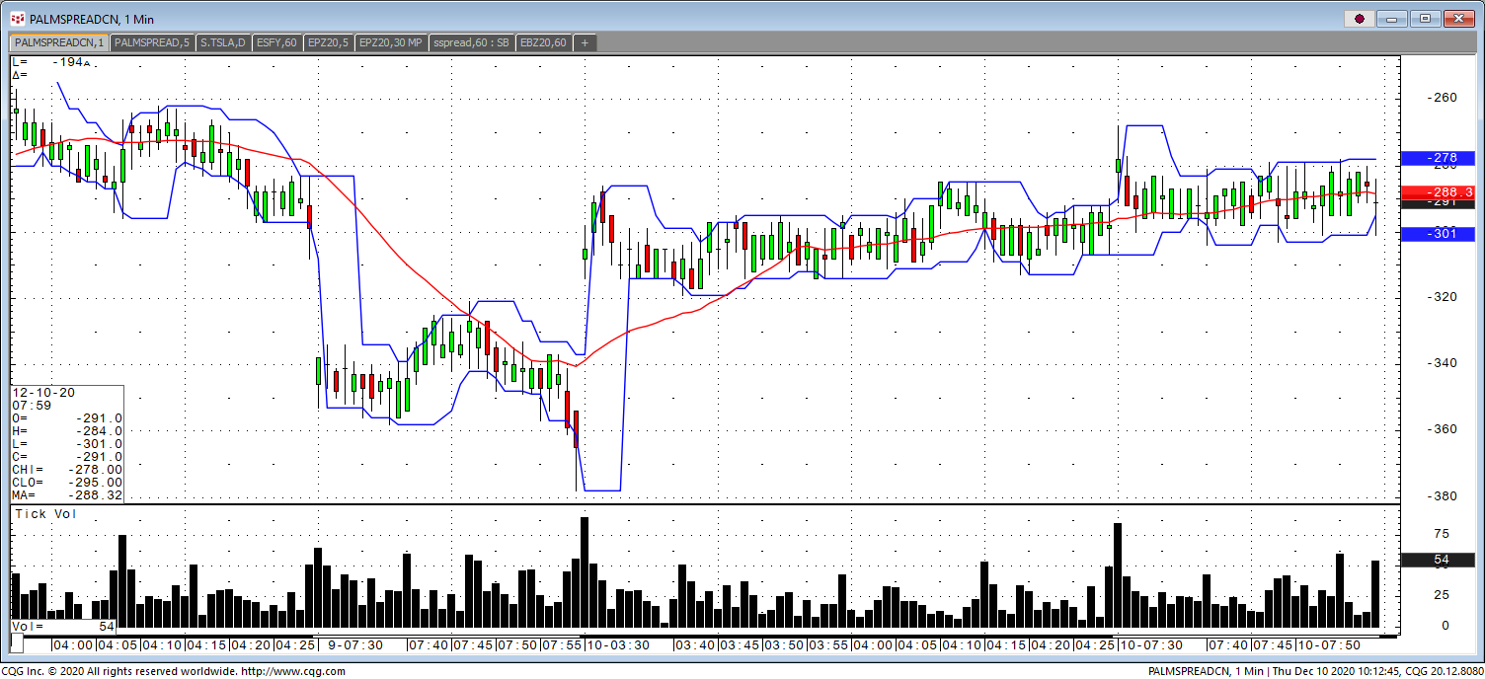
CQG Spreader - Analytics

Slide 10
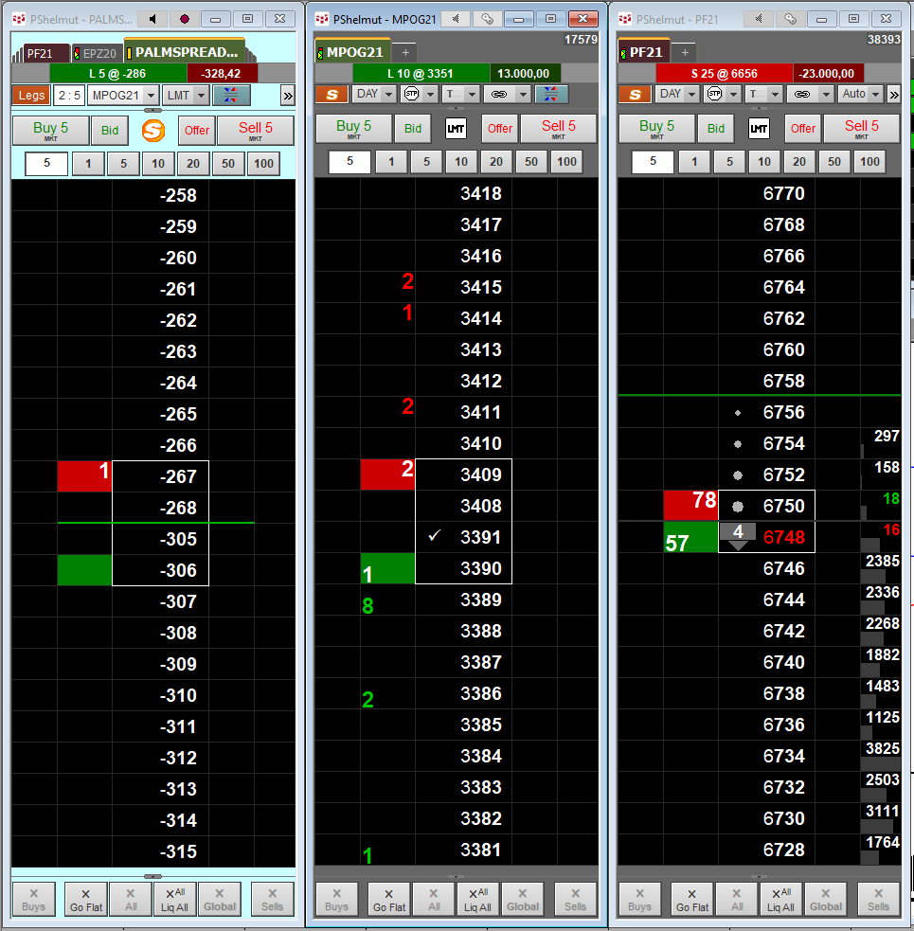
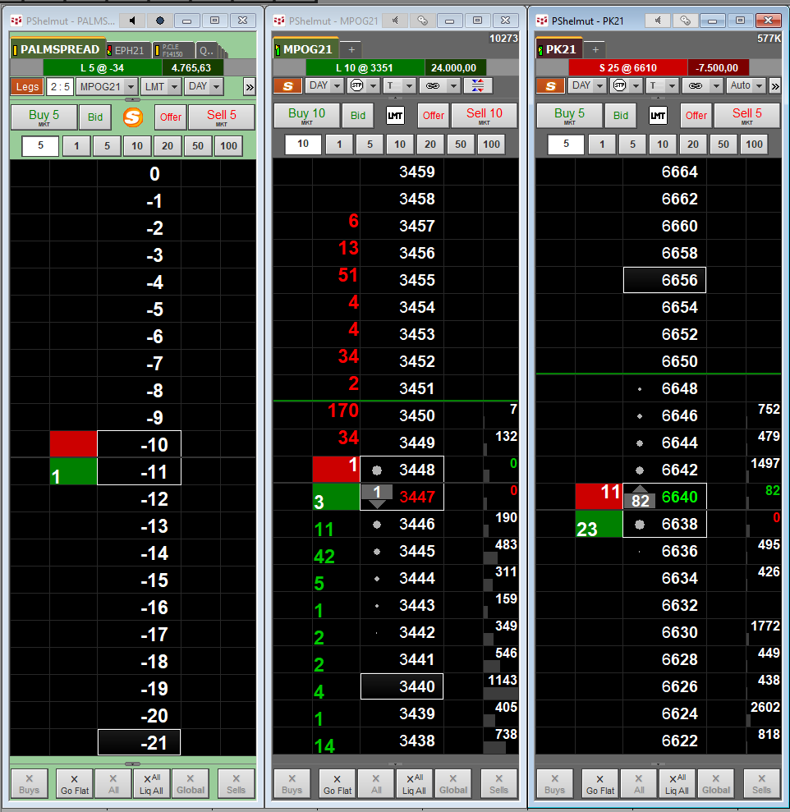
CQG Spreader - Trading

Slide 11
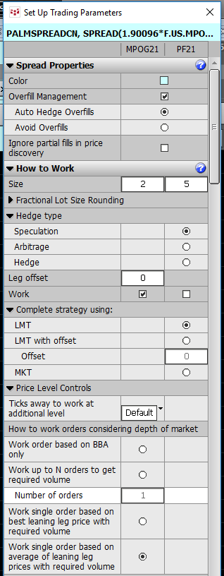
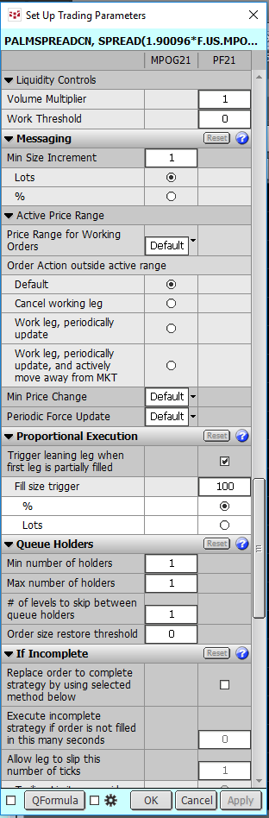
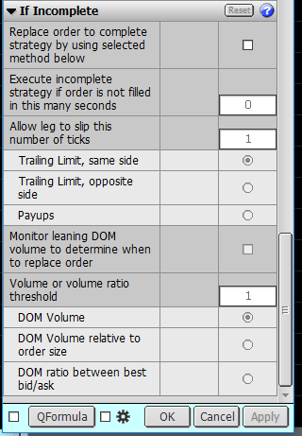
CQG Spreader - Parameter

Slide 12
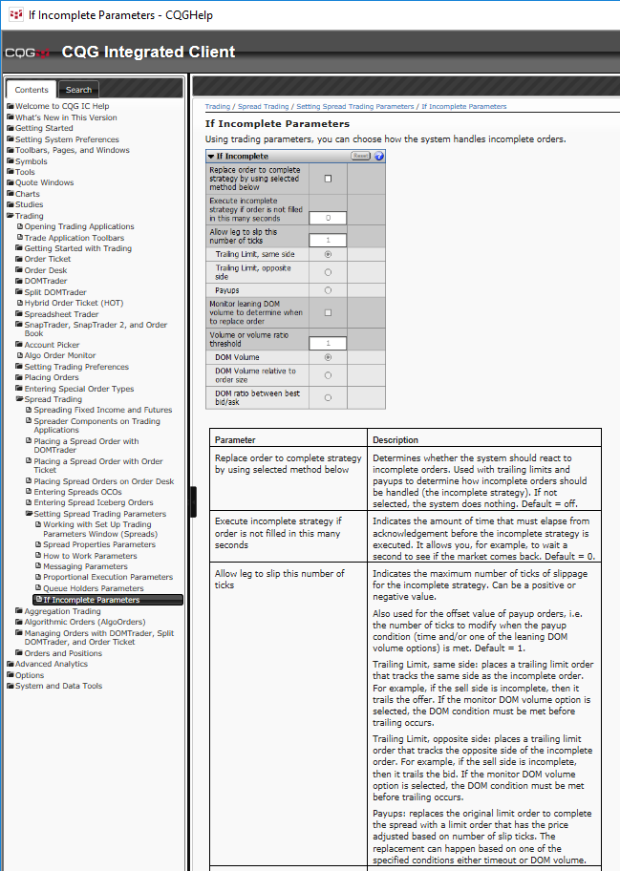
CQG Spreader - Help

Slide 13
CQG Spreader
Questions?

Slide 14
CQG Spreader
Thank you !

Slide 15
Contact Us
CQG, Inc. is the industry’s highest-performing solution for integrated trade routing, global market data, and advanced technical analysis. CQG partners with more than forty Futures Commission Merchants and provides Direct Market Access to more than thirty-five exchanges through its worldwide network of collocated CQG Hosted Exchange Gateways. CQG's market data feed consolidates over a hundred sources, including exchanges worldwide for futures, options, fixed income, foreign exchange, and equities as well as data on debt securities, industry reports, and financial indices. CQG is headquartered in Denver, Colorado with sales and support offices worldwide. For more information about CQG, please call 1-800-525-7082 or visit www.cqg.com.
Customer Support:
  US: 1 800-525-1085
  UK: +44 (0) 20-7827-8270
  Australia: +61 (0) 2-9235-2009
  France: +33 (0) 1-74-18-07-81
  Germany: +49 (0) 69-6677-7558-0
  Japan: +81 (0) 3-3286-6877
  Russia: +7 495-795-2409
  Singapore: +65 6494-4911

Slide 16
Disclaimer
Trading and investment carry a high level of risk, and CQG, Inc. does not make any recommendations for buying or selling any financial instruments. We offer educational information on ways to use our sophisticated CQG trading tools, but it is up to our customers and other readers to make their own trading and investment decisions or to consult with a registered investment advisor.
© 2009 CQG, Inc. All rights reserved worldwide.
CQG®, DOMTrader®, SnapTrader®, TFOBV®, TFOBVO®, TFVOL®, TradeFlowTM, and TFlowTM are trademarks of CQG, Inc.

